Slide 1
AMC Entertainment Holdings
Sureya Banu
Thomas Buckman
Maria Caballeros
Tiffany Fuentes
Komalba Jadeja

Slide 2
Market and Economics
Fears over how the omicron variant of Covid-19 could impact attendance at movie theaters.
AMC plans to turn back to M&A
AMC has been able to raise the cash because of continued volatility in its stock.
Streaming war
AMC is pivoting to showing sports

Slide 3
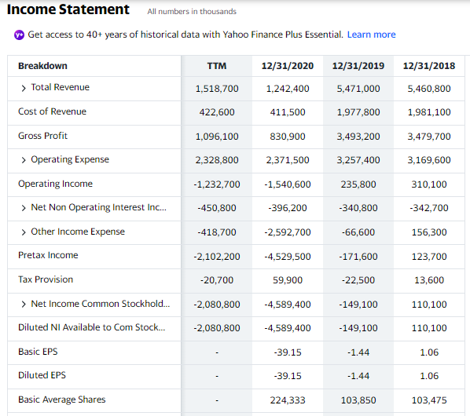

Slide 4
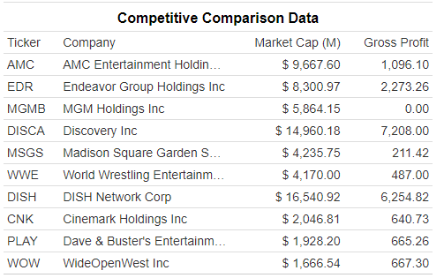
Gross profit
AMC Entertainment Holdings gross profit for the quarter ending September 30, 2021 was $0.544B, a 546.61% increase year-over-year.
AMC Entertainment Holdings gross profit for the twelve months ending September 30, 2021 was $1.096B, a 33.74% decline year-over-year.
AMC Entertainment Holdings annual gross profit for 2020 was $0.831B, a 76.21% decline from 2019.

Slide 5
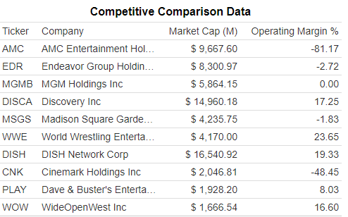
Operating Margin
AMC Entertainment Holdings' Operating Margin % for the quarter that ended in Sep. 2021 was -15.55%.
AMC Entertainment Holdings Inc had lost money in 67% of the time over the past 12 quarters.

Slide 6
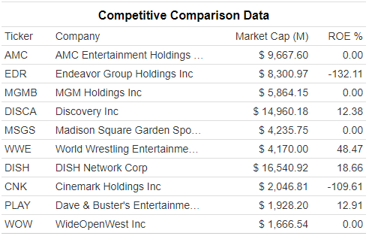
Return on equity
AMC Entertainment Holdings' ROE % for the quarter that ended in Sep. 2021 was 0.00%.
ROE deteriorated compare to previous period, despite net income growth.

Slide 7
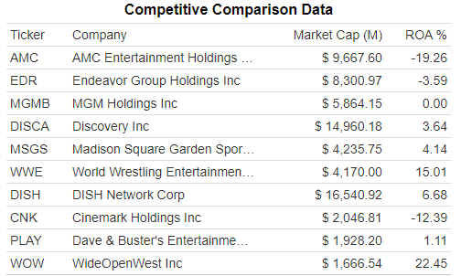
Return on Assets
AMC Entertainment Holdings' annualized ROA % for the quarter that ended in Sep. 2021 was -8.01%.
AMC Entertainment Holdings' ROA % is ranked lower than 87% of the 1018 Companies in the Media - Diversified industry.

Slide 8
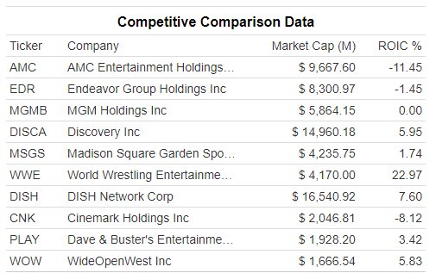
Return on investment
AMC Entertainment Holdings’ ROIC % is -11.45%
AMC Entertainment Holdings' WACC % is 5.59%.
AMC Entertainment Holdings' annualized return on invested capital (ROIC %) for the quarter that ended in Sep. 2021 was -4.55%.

Slide 9
S
W
O
T
STRENGTH
WEAKNESS
OPPORTUNITY
THREATS
Strong Brand Recognition
Market Leadership Position
Innovation
Diverse Revenue models
Decline in Revenue
High Cost (supply chain and knowledge)
Loyalty among suppliers
Expansion
Local Collaboration
Technological Innovation
Competitive pressure
Changing demographics
Commoditization

Slide 10
Strategic Plan
Use fresh funds (predominantly from stock sales)
Consider paying down some of its debt
Expansion of U.S. theater locations
Several new acquisitions
ArcLight and Pacific theaters
Multi Million dollar ad campaign
Become the biggest theater owner and even larger theater tenant

Slide 11
Marketing Strategy & Appeal
AMC is known to center their marketing strategy based on personal advertisements & social media outreach
Their partnership with Movio, helps them follow through with this strategy successfully because Movio focuses on customer content specified by their taste in movies.
This helps AMC advertise the right genre of movies to the corresponding customers
The companies that AMC competes with, force them to adapt and make the movie going experience as cozy & comfortable as possible with good seating & food
AMC collaborates with the six biggest studios (20th century fox, paramount pictures, warner bros., universal pictures, columbia pictures, & walt disney) to gain a monopoly on movie releases

Slide 12
Lines of Business
Since 2015 - 2019 AMC revenue has increased by 19% (movio might be a good reason for this)
From 2016-2017 revenue grew 58.4% due to the acquisition of Odeon, Carmike, & Nordic along with good food & beverage initiatives, & enhancements in movie viewing
Biggest Investors - Vanguard Group, BlackRock Fund Advisors, SSgA Funds Management, Geode Capital Management, Northern Trust Investment, Charles Schwab, BlackRock Investment Management, Renaissance Tech, D E Shaw & Co.
Covid shutdown AMC making it hard to predict the trend of where it will go in the future

Slide 13
Corporate Governance
Corporate governance in the business context refers to the systems of rules, practices, and processes by which companies are governed.
It ensures everyone in an organization follows appropriate and transparent decision-making processes and that the interests of all stakeholders, may it be shareholders, managers, employees, suppliers, customers, etc., are protected.
And there is a clear distinction between the role of the owners of a company (the shareholders) and the managers (the executive board of directors) when it comes to making effective strategic decisions.

Slide 14
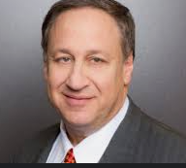
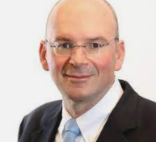


Board Members
Adam Aron: CEO of AMC;
MBA, Harvard University; 35+ years of experience.
Sean D. Goodman:Chief Financial Officer & Executive Vice President.
MBA, Harvard University;
Derrick leggett:
Senior Vice President Information Technology,
MBA,Northwestern University.
John McDonald: Executive Vice President US Operations. MBA,UCLA Anderson School of Management
https://investor.amctheatres.com/governance/senior-officers-board-of-directors/default.aspx

Slide 15
AMC: Litigations
Investor, John Lyon III has sued the board members on Sep 2021 in Manhattan after they refused his demand to independently investigate claims made in a securities fraud class action over the deal.
https://www.reuters.com/legal/litigation/amc-investor-sues-board-over-12-bln-carmike-acquisition-2021-09-23/
Proposed class action lawsuit by Miller Shah LLP on Nov 2021 on Behalf of Purchasers of AMC Entertainment Holdings, Inc. Common Stock
https://www.prnewswire.com/news-releases/miller-shah-llp-announces-proposed-class-action-settlement-on-behalf-of-purchasers-of-amc-entertainment-holdings-inc-common-stock----amc-301427085.html

Slide 16
“What/If” Analysis
Accept
Factors:
Stock growth in last year
Raised approx $587 M new equity capital
Future acquisition plans
Opening new theatres worldwide
Reject
Factors:
Stock down in last quarter
Board members selling stocks
Ongoing pandemic
Litigations
Foreign Government Policies

Slide 17
Final Decision
The following aspects were taken into consideration
Risks related with COVID uncertainty
Streaming alliances
Acquisitions
Loan will be granted with the following terms
Strong collateral
Mandatory loan insurance
Strict repayment plan

Slide 18
Bibliography
“AMC.” CNNMoney, Cable News Network, https://money.cnn.com/quote/shareholders/shareholders.html?symb=AMC&subView=institutional.
“AMC Theatres Focuses on Matching Mobile Content to Film Tastes.” Marketing Dive, https://www.marketingdive.com/ex/mobilemarketer/cms/news/advertising/20372.html.
“Strategic Plan.” AMC, http://amcgroup2.weebly.com/strategic-plan.html.
Nebres, Karin. “AMC Strategic Marketing Plan.” Medium, Medium, 7 Dec. 2021, https://medium.com/@nebres.karin/amc-strategic-marketing-plan-cd99195e4761.
“AMC Entertainment Holdings, Inc.. Announces Fourth Quarter and Year-End 2017 Results.” AMC Entertainment Holdings, Inc. Announces Fourth Quarter and Year-End 2017 Results | Business Wire, 1 Mar. 2018, https://www.businesswire.com/news/home/20180301005474/en/AMC-Entertainment-Holdings-Inc.-Announces-Fourth-Quarter-and-Year-End-2017-Results.

